Slide 1
Data Science III: Scaling, Applications, Responsibility
IMT 575

Slide 2
Instructor Introduction (15 minutes)
Project Introduction (10 minutes)
Lab 1 Setup (30 minutes)
Reading Response (15 minutes)
Open Q&A on Module (10 minutes)
Review (5 minutes)

Slide 3
Topics by Week
Data Science in the Wild
Infrastructure for Big Data Science
Abstractions for Big Data Programming
Introduction to Deep Neural Networks
Text-as-Data and NLP with Neural Methods
Image processing with Neural Networks
Privacy and Ethics
Algorithmic Bias
Visualization and Communication
Project Presentations

Slide 4
Lab Assignments
Twitter (Python, data wrangling)
MapReduce Algorithm Design (Python, MapReduce)
Spark (optional; requires AWS account, SQL, Spark)
Neural Networks from scratch (Python)
NN Text Classification (Python, sklearn, Universal Sentence Embedder)
NN Image Classification (Python, Keras, Tensorflow)
Randomized Response exercise (we may skip this)
Fair Machine Learning (Python, Microsoft’s FairLearn, IBM 360 Fairness)
Design a visualization (your choice; Python recommended)
Lightning Talk (live session) + Practice Talk (peer review)

Slide 5
Course Project
You choose a dataset and 1-4 questions to answer
Usually will involve some prediction component, but not necessarily
Ex: The question “Do liberal or conservative sources produce more misinformation?” may involve predicting partisanship and predicting misinformation
Projects need not involve very large datasets; it’s usually difficult to work with big data in a 10-week project
Get to know your data and questions:
The best projects usually involve directly available data, simple yet creative questions, and thorough interpretation of results
Weaker projects may just train 3-4 different ML algorithms and report accuracy

Slide 6
Course Project (2)
Four milestones
Project Proposal
Project Plan
Draft Presentation
Final Deliverables (Video and Supporting Report)
Milestones overlap with lab assignments
Peer Review of project milestones
Week 4 (proposal), Week 6 (plan), Week 8 (draft presentations)
Final Presentations in week 10

Slide 7
a spanning basis of data science examples

Slide 8
My view:
Data science is about answering questions using large, noisy, and heterogeneous datasets
It’s about insight, not advanced methods
But: Data management is data science, too
Notes:
The challenges stem from the large, noisy, and heterogeneous more than from colelcting the data in the first place.
Data scie

Slide 9

Question:
How has the popularity of genres of music changed over time?
Data:
List of artists with user-supplied genre tags; playlists from users

Slide 10
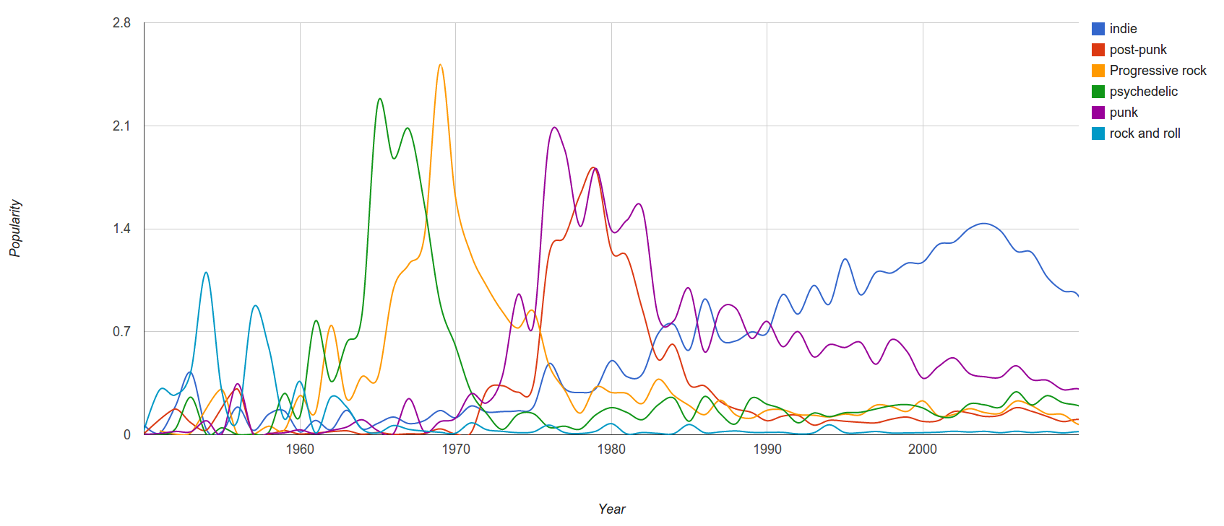
Last.FM
“Since we have a massive amount of user tag data available we can easily correlate tags and years and measure “popularity” of a genre by counting the number of artists formed in a specific year.”
Janni Kovacs, Last.FM

Slide 11

Question:
How early and accurately can we predict flu outbreaks, so we can plan production levels of flu vaccine?
Dataset:
Search histories of users

Slide 12
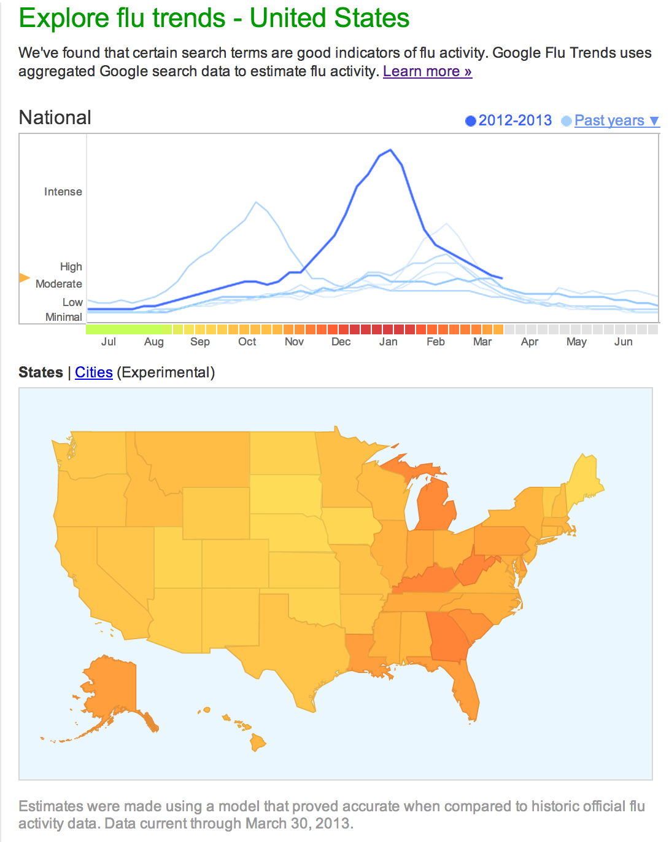
source:
http://www.google.org/flutrends/us/#US
flu risk
“Scientific hindsight shows that Google Flu Trends far overstated this year's flu season….”
“Lots of media attention to this year's flu season skewed Google's search engine traffic.”
David Wagner, Atlantic Wire, Feb 13 2013
http://www.google.com/permissions/using-product-graphics.html
Notes:
Google

Slide 13
Question:
Do people that take paroxetine and pravastatin together exhibit hypoglycemia symptoms?
Dataset:
Search engine histories

Slide 14
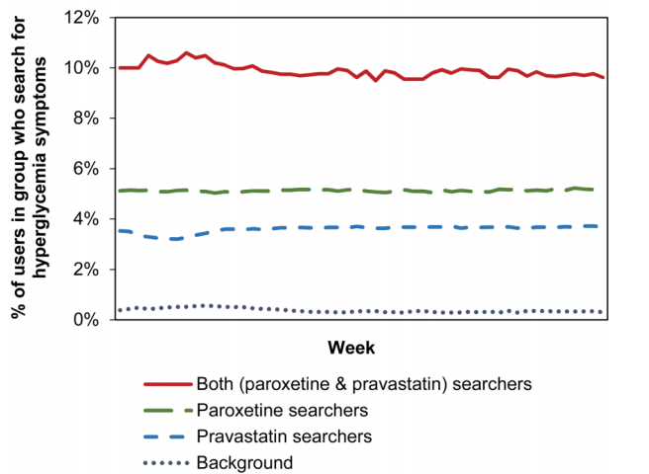
Ryen W White,Nicholas P Tatonetti, Nigam H Shah, Russ B Altman, Eric Horvitz, Web-scale pharmacovigilance: listening to signals from the crowd, J Am Med Inform Assoc, March 2013, doi:10.1136/amiajnl-2012-001482

Slide 15
Question:
What pairs of foods go well together?
Data:
Large repositories of recipes

Slide 16
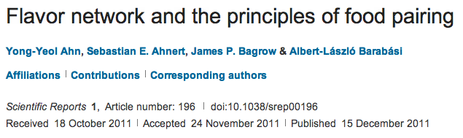
Idea: Analyze the co-occurrence graph of ingredients in recipes to analyze the underlying principles of food pairing.

Slide 17
Question:
Has the expression of emotion in the literature changed over time?
Dataset:
Literature over the last 100 years

Slide 18
Acerbi A, Lampos V, Garnett P, Bentley RA (2013) The Expression of Emotions in 20th Century Books. PLoS ONE 8(3): e59030. doi:10.1371/journal.pone.0059030
1) Convert all the digitized books in the 20th century into n-grams (Thanks, Google!)
(http://books.google.com/ngrams/)
2) Label each 1-gram (word) with a mood score.
(Thanks, WordNet!)
3) Count the occurences of each mood word
A 1-gram: “yesterday”
A 5-gram: “analysis is often described as”
Notes:
Researchers were able to chart historical periods of positive and negative moods through literature. Values above zero indicate generally "happy" periods, and values below the zero indicate generally "sad" periods.

Slide 19
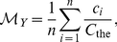
sum of all the occurrences of words with a particular mood
number of occurrences of word i
number of occurrences of the word “the”
divide by the number of words with that mood label

Slide 20
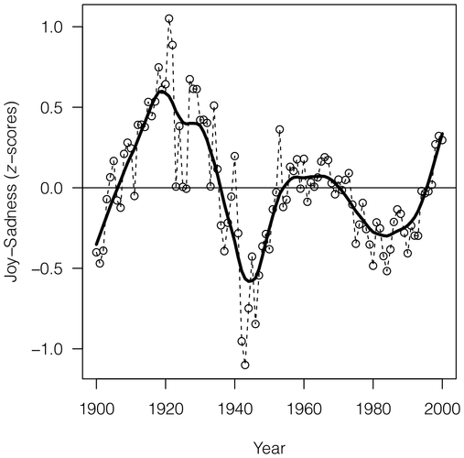
Acerbi A, Lampos V, Garnett P, Bentley RA (2013) The Expression of Emotions in 20th Century Books. PLoS ONE 8(3): e59030. doi:10.1371/journal.pone.0059030
Notes:
Researchers were able to chart historical periods of positive and negative moods through literature. Values above zero indicate generally "happy" periods, and values below the zero indicate generally "sad" periods.

Slide 21
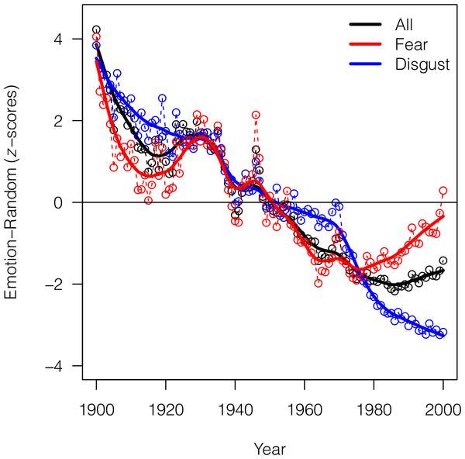
Acerbi A, Lampos V, Garnett P, Bentley RA (2013) The Expression of Emotions in 20th Century Books. PLoS ONE 8(3): e59030. doi:10.1371/journal.pone.0059030

Slide 22
Question:
How do we measure the influence of a scientific paper?
Dataset:
Citation network between papers

Slide 23
Citation Graph
Notes:
Let’s take a very different example, and arguably even more important: How can we analyze science itself?
Researchers publish papers that cite other papers. One simple measure of importance is to count the number of times your work is cited.
But it’s better to be cited by papers that are themselves important --

Slide 24
Key Takeaways:
Data science is pervasive: it’s affecting every field
It’s about answering questions using data often collected for some other purpose
The challenges are often around scale, bias, engineering, and interpretation – how do we extract information from large, noisy, heterogeneous sources?
Insight is more important than methods

Slide 25
Perspectives on Data Science

Slide 26
Three views I’d like to share
Skills Perspective
Drew Conway’s Venn Diagram
Task Perspective
Data Science “Workflow”
Output Perspective
“Data Products”

Slide 27
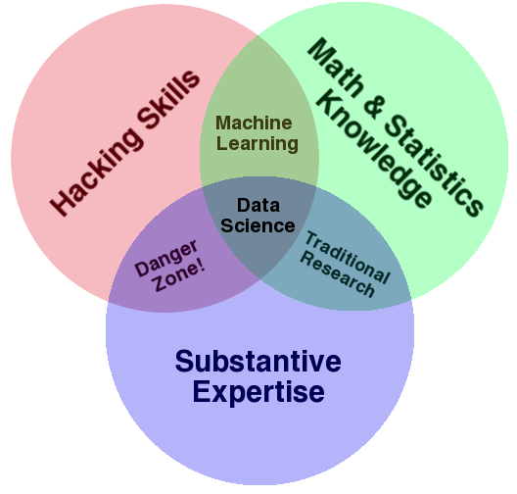
Skills Perspective: Drew Conway’s Data Science Venn Diagram

Slide 28
“I worry that the Data Scientist role is like the mythical “webmaster” of the 90s: master of all trades.”
-- Aaron Kimball, CTO Zymergen

Slide 29
Task Perspective: A Typical Data Science Workflow
DB
1) Preparing to run a model
2) Running the model
3) Interpreting the results
“80% of the work”
Gathering, cleaning, integrating, restructuring, transforming, loading, filtering, deleting, combining, merging, verifying, extracting, shaping, massaging
ML/Stats
Vis
“The other 80% of the work”

Slide 30
Output perspective: Data Science is about Data Products
“Data-driven apps”
Spellchecker
Machine Translator
Interactive visualizations
Google flu application
Global Burden of Disease
Online Databases
Enterprise data warehouse
Sloan Digital Sky Survey
(Mike Loukides)
Data science is about building data products, not just answering questions
Data products empower others to use the data.
May help communicate your results (e.g., Nate Silver’s maps)
May empower others to do their own analysis
(e.g., Global Burden of Disease)
Notes:
Data Science is about creating data products.

Slide 31
The Data Scientific Method
Start with a Question
Leverage your current data
Create features and run tests
Analyze the results and draw insights
Let the data frame a conversation
src: DJ Patil, Josh Elman, LeWeb, London, 2012

Slide 32
Science
Data Science
Science
Start with a question
Data Science
Start with a question, and typically some existing data
What are the risks and benefits of these approaches?
Is there always a choice?
Does one subsume the other?
Notes:
you trade skills in data acquisition “field work” for additional skills in data analysis.
Everyone is becoming a data scientist.

Slide 33
What about “Big Data”?

Slide 34
Big Data vs. Statistics
Statistics is about drawing inferences about a population based on the properties of a sample
What if we have access to (almost) the entire population?
All the credit card transactions
All the papers
All the clicks
All the photographs

Slide 35
What about Big Data?
“Classical statistics was fashioned for small problems, a few hundred data points at most, a few parameters.”
“The bottom line is that we have entered an era of massive scientiﬁc data collection, with a demand for answers to large-scale inference problems that lie beyond the scope of classical statistics.”
Bradley Efron,
Bayesians, Frequentists, and Scientists
http://www-stat.stanford.edu/~ckirby/brad/papers/2005BayesFreqSci.pdf

Slide 36
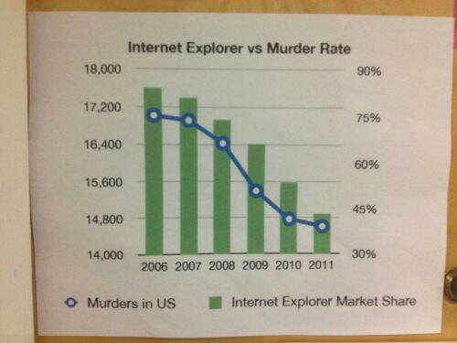

Slide 37
Positive Correlations
Number of police officers and number of crimes (Glass & Hopkins, 1996)
Amount of ice cream sold and deaths by drownings (Moore, 1993)
Stork sightings and population increase
(Box, Hunter, Hunter, 1978)

Slide 38
The “curse” of Big Data?
“…the curse of big data is the fact that when you search for patterns in very, very large data sets with billions or trillions of data points and thousands of metrics, you are bound to identify coincidences that have no predictive power.”
Vincent Granville
http://www.analyticbridge.com/profiles/blogs/the-curse-of-big-data
Notes:
Cross correlations of timeseries data?
Stock prices for 24 hours from 1000 companies
Run correlation: sum

Slide 39
Vincent Granville’s Example
Consider stock prices for 500 companies over a 1-month period
Check for correlations in all pairs

Slide 40
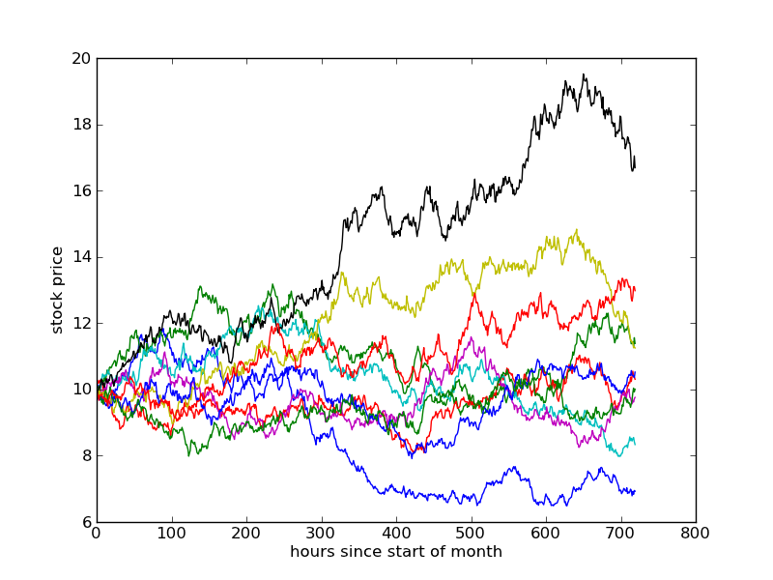
random walk
each step is normally distributed @ 1% of current price
t0
t1
t2

Slide 41
Aside: Cross-correlation of timeseries
What happens when both are high at time i? Both low? One high, one low?
Input: two sequences (x₀, x₁, … x_{n}), (y₀, y₁, … y_{n})
Mean of sequence x
Mean of sequence y
standard deviation of x
standard deviation of y
Notes:
\text{corr}(x,y) = \frac{cov(x,y)}{\sqrt{\sum_i(x_i-u_x)^2}\sqrt{\sum_i(y_i-u_y)^2}}
\text{cov}(x,y)=\frac{1}{N}\sum^N_i(x_i-u_x)(y_i-u_y)

Slide 42
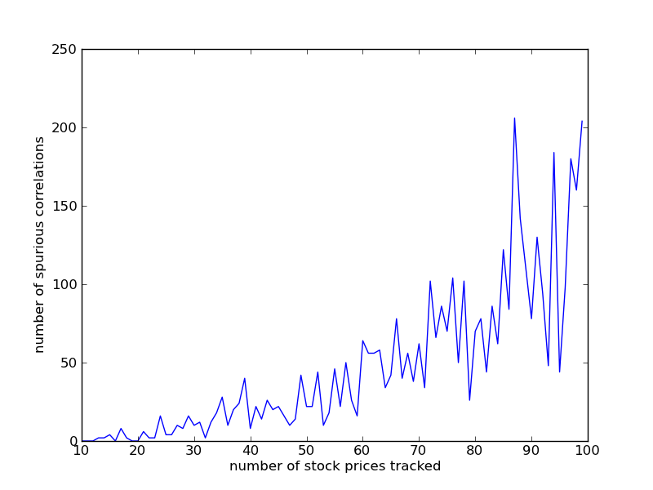
If we have 500 companies, how many pairs are we checking for correlation?
This plot: How many of the pairs are at least 90% correlated?
correlation threshold = 0.9
Hundreds of spurious correlations!
When tracking 100 companies, we may find ~100 pairs that appear to be very strongly correlated.
None of this is real!!

Slide 43
Is Big Data different? Some ways it might be…
Big P vs. Big N
P = number of variables (columns)
N = number of records
Marginal cost of increasing N is essentially zero!
But while >N decreases variance, it amplifies bias
Ex: You log all clicks to your website to model user behavior, but this only samples current users, not the users you want to attract.
Ex: Using mobile data to infer buying behavior or traffic patterns?
Beware multiple hypothesis tests
“Green jelly beans cause acne”

Slide 45
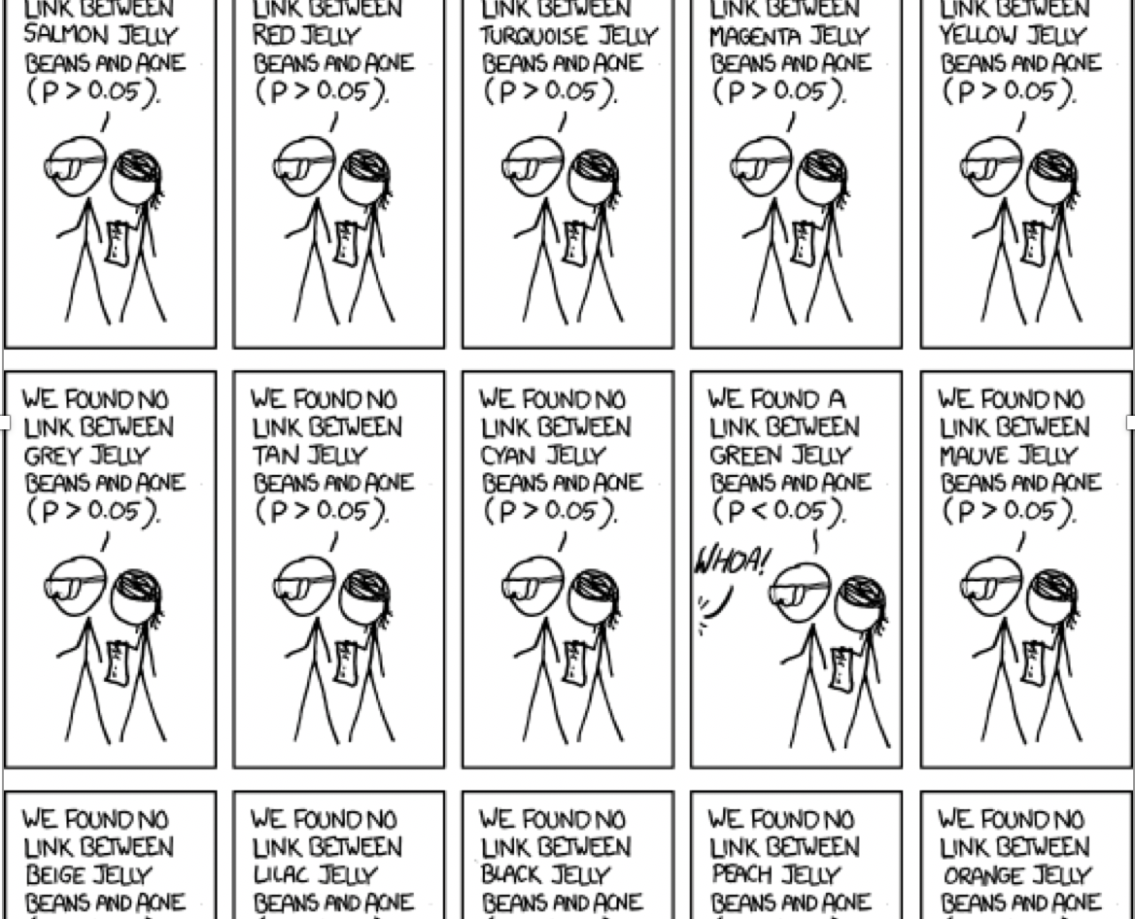

Slide 46
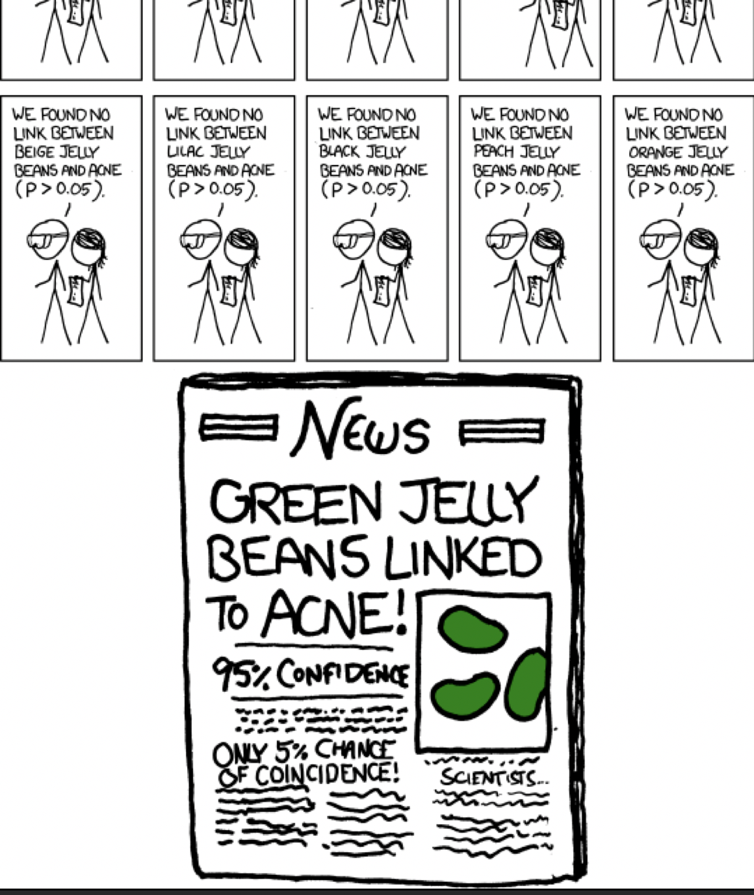

Slide 47
Other concerns

Slide 48
Jonah Lehrer, 2010, The New Yorker
The Truth Wears off
John Davis, University of Illinois
“Davis has a forthcoming analysis demonstrating that the efficacy of antidepressants has gone down as much as threefold in recent decades.”
Anders Pape Møller, 1991
“female barn swallows were far more likely to mate with male birds that had long, symmetrical feathers”
“Between 1992 and 1997, the average effect size shrank by eighty per cent.”
Jonathan Schooler, 1990
“subjects shown a face and asked to describe it were much less likely to recognize the face when shown it later than those who had simply looked at it.”
The effect became increasingly difficult to measure.
Joseph Rhine, 1930s, coiner of the term extrasensory perception
Tested individuals with card-guessing experiments. A few students achieved multiple low-probability streaks. But there was a “decline effect” – their performance became worse over time.
http://www.newyorker.com/reporting/2010/12/13/101213fa_fact_lehrer
Notes:
This week we’re going to talk about estimation and prediction.
I want to begin with a non-research article from 2010 by Jonah Lehrer. In this article, the author describes cases where once-promising research results become weaker over time – they become harder to replicate, or the effect size becomes smaller.
He quotes John Davis speaking about the efficiacy of antidepressants, saying…
He talks about Anders Moller, a biologist who made an important discovery based on precise measurements of symmetry in the plumage of barn swallows, only to find the effect size shrank by 80 percent in the studies following the initial paper.
Jonathan Schooler made a discovery he called verbal overshadowing, which showed, counter-intuitively, that talking about something someone’s face made it harder to recognize later rather than easier. But this effect too became weaker over time.
Back in the 1930s, Joseph Rhine, a researcher at Duke Unviersity who coined the terms parapscyhology and etrasensor perception, reported data showing that some invdividuals could correctly guess the symbols on special cards without seeing them in remarkably long streaks. But the same individuals’ performance would decline over time. He called it the decline effect.
What’s going on? The article offers some sensible and some not-so-sensible ideas about the root cause.

Slide 49
Publication Bias
“In the last few years, several meta-analyses have reappraised the efficacy and safety of antidepressants and concluded that the therapeutic value of these drugs may have been significantly overestimated.”
“Although publication bias has been documented in the literature for decades and its origins and consequences debated extensively, there is evidence suggesting that this bias is increasing.”
“A case in point is the field of biomedical research in autism spectrum disorder (ASD), which suggests that in some areas negative results are completely absent”
(emphasis mine)
“… a highly significant correlation (R²= 0.13, p < 0.001) between impact factor and overestimation of effect sizes has been reported.”
Publication bias: What are the challenges and can they be overcome?
Ridha Joober, Norbert Schmitz, Lawrence Annable, and Patricia Boksa
J Psychiatry Neurosci. 2012 May; 37(3): 149–152. doi: 10.1503/jpn.120065
Notes:
One culprit is publication bias.
Joober et al. in 2012
You can’t roll the dice a bunch of times then yell “Yahtzee!”

Slide 50
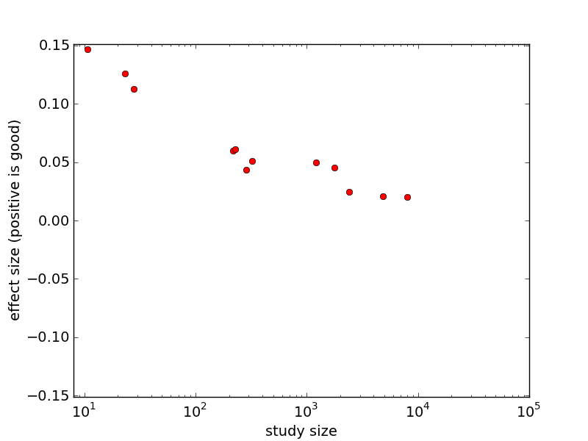
Publication Bias (2)
“decline effect”
Notes:
Here’s a simulation of what Rhine in the 1930s referred to as the decline effect.
As the study size increases, the effect size diminishes. Other metrics on the x and y axes are possible: x-axis might be improvements in experimental design, y-axis might be statistical significance.
The units of effect size will be application specific – number of smokers who quit, number of T-cells in the blood, amount of ad revenue generated, etc. Something that measures how “good” the result is.

Slide 51
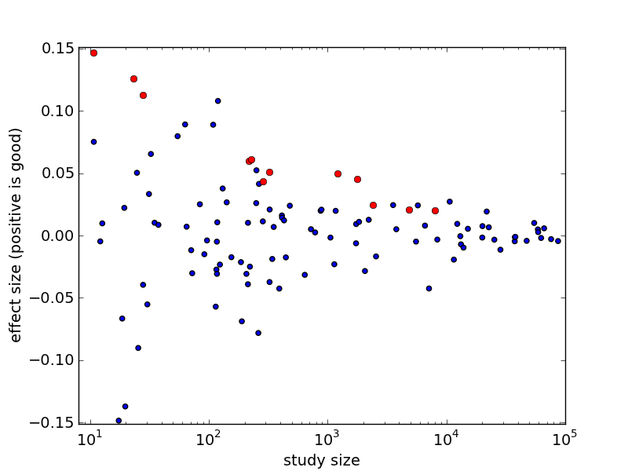
“decline effect” = publication bias!
Notes:
You can’t roll the dice a bunch of times then yell “Yahtzee!”

Slide 52
What is the rate-limiting step in data understanding?
Processing power: Moore’s Law
Amount of data in the world
Notes:
And processing power, either as raw processor speed or via novel multi-core and many-core architectures, is also continuing to increase exponentially…

Slide 53
What is the rate-limiting step in data understanding?
Amount of data in the world
Processing power: Moore’s Law
Human cognitive capacity
Idea adapted from “Less is More” by Bill Buxton (2001)
slide src: Cecilia Aragon, UW HCDE
Notes:
… but human cognitive capacity is remaining constant. How can computing technologies help scientists make sense out of these vast and complex data sets?

Slide 54
Key Takeaways:
Data science is different than statistics: large, noisy, heterogeneous, inherited datasets instead of small, purposefully acquired datasets.
With large N and large P, there’s an even greater risk of being fooled by spurious results.

